Slide 1
SELF LEARNING BINARY SEARCH TREE FOR JAVA OBJECTS
TEAM MEMBERS
1.ABHISHEK M (16030141CSE006)
2.JAY DEV RAI M (16030141CSE037)
3.MEGHANA S (16030141CSE054)
4.NAVEEN KUMAR J R (16030141CSE059)
UNDER THE GUIDANCE
Prof. VIJAYALAKSHMI

Slide 2
ABSTRACT
A smart data structure which combines two of
the technologies that is Binary Search Tree data
structure and Unsupervised machine learning in
order to make the retrieval of the data faster
based on the type of the data that is stored in this
data structure.

Slide 3
OBJECTIVES
For large software systems people use huge volume of data, in order to store this huge volume of data and retrieve this data is time consuming. So in order to reduce the time the machine learning data will learn how the people are accessing it. So, based on the we will reduce the time for accessing the data based on machine learning.
It will mainly be used for server side java application where millions of data needs to be stored and accessed in real time.

Slide 4
CHAPTER 1 INTRODUCTION

Slide 5
STATEMENT AND EXPLANATION OF THE BASIC PRINCIPLE
Data Structure plays an important role when we are processing the data in primary memory.
A data structure must be capable of fast retrieval and storage in order to boost the performance of any application.
Our aim is to make a custom Binary Search Tree which will be able to restructure itself in order to make the retrieval faster. This restructuring will be based on machine learned ranking.
2.STATE OF ART
Data Structures
* Data
* Group Items
* Record
* File
* Attribute and Entity
* Field
Importance of data structures
* Processor Speed
* Data Search
* Mutltiple Requests

Slide 6
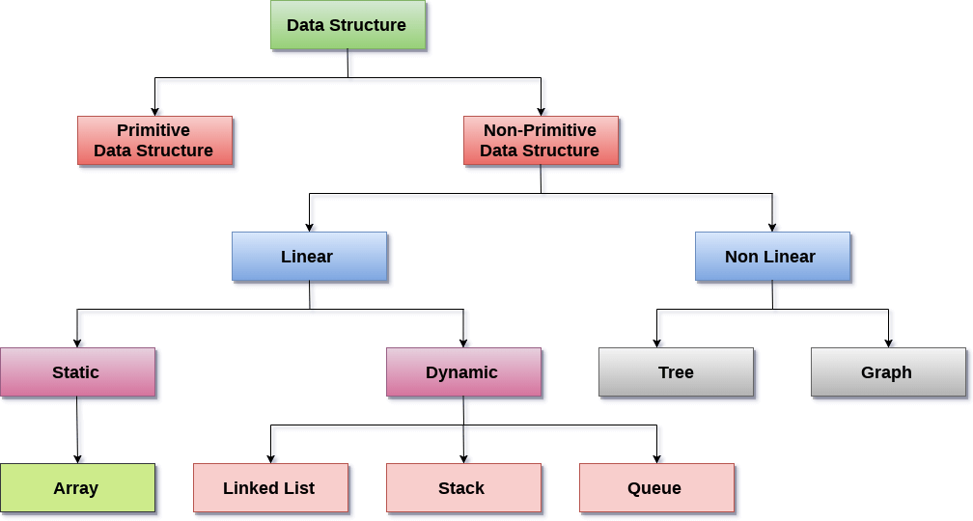
Types of Data Structure
Binary Search Tree
Treap

Slide 7
3. UNSUPERVISED RANK AGGREGATION
Text similarity
Distance Based Priority
4. WHAT HAS BEEN DONE IN THE PROJECT?
5.Chapter-Wise Summary Of the Project

Slide 8
CHAPTER 2 LITERATURE SURVEY

Slide 9
Literature Survey
1.Title: Unsupervised Rank Aggregation with Distance-Based Models
Author: Alexandre Klementiev, Dan Roth, Kevin Small
2.Title: Combining feature ranking algorithms through rank aggregation
Author: Ronaldo C. Prati
3.Title: An Unsupervised Learning algorithm for rank aggregation
Author: Alexandre Klementiev, Dan Roth, Kevin Small
4.Title: A Statistical Convergence Perspective of algorithms for rank aggregation from pair wise data
Author: Arun Rajkumar, Shivani Agarwal
5.Title: Spectral Feature Selection for supervised and unsupervised learning
Author: Zheng Zhao, Huan Liu

Slide 10
CHAPTER -3 SYSTEM REQUIREMENTS

Slide 11
SOFTWARE AND HARDWARE REQUIREMENTS
SOFTWARE REQUIREMENTS
Operating system : Windows 10, Ubuntu
Coding Language : Python 3, Java 8
HARDWARE REQUIREMENTS
System : Intel Core i3 and above
Hard Disk : 512GB
Monitor : 15’’LED
Input Device : Keyboard , Mouse
Ram : 8GB DDR4

Slide 12
CHAPTER -4 ANALYSIS

Slide 13
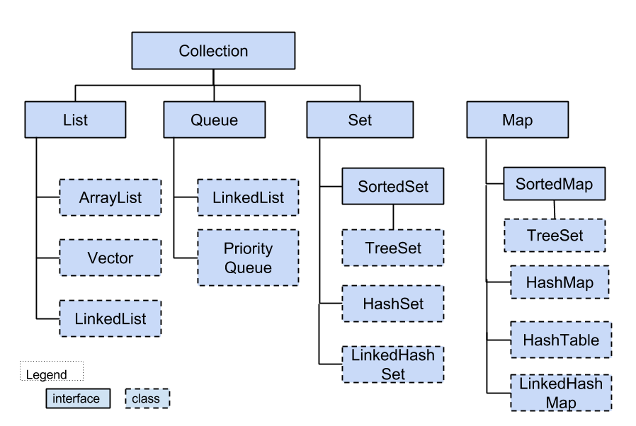
EXISTING SYSTEM

Slide 14
PROPOSED SYSTEM
Smart Structure
A jar file containing the data structure along with the integrated
functioning machine learning algorithm.

Slide 15
CHAPTER 5 DESIGN AND IMPLEMENTATION

Slide 16
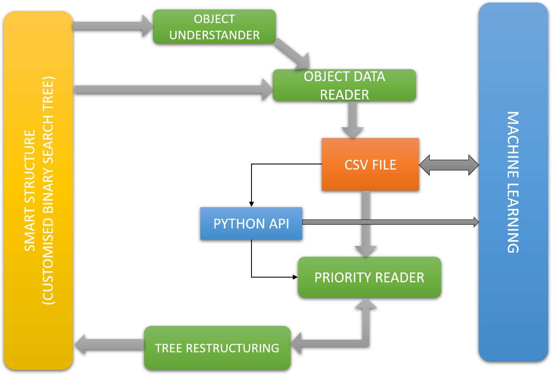
SYSTEM ARCHITECTURE
Smart Tree Architecture

Slide 17
SYSTEM MODULES
DATA STRUCTURE
CUSTOM BINARY SEARCH TREE
OBJECT UNDERSTANDER
OBJECT DATA WRITER
PYTHON API
PRIORITY READER
PRIORITY SETTER
TREE RESTRUCTURING

Slide 18
B.Machine Learning Architecture
CSV FILE
OBJECT READER
DATA SPLITTER
UNSUPERVISED MACHINE LEARNING
PRIORITY WRITER
PRIORITY CALCULATOR

Slide 19
SYSTEM MODULES
MACHINE LEARNING
OBJECT DATA READER
DATA PARTITIONING
DISTANCE BASED UNSUPERVISED LEARNING
PRIORITY CALCULATOR
PRIORITY WRITER

Slide 20
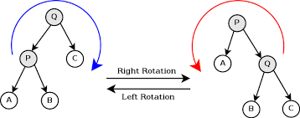
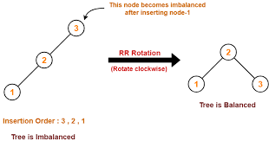
ALGORITHMS – TREE ROTATION

Slide 21
ALGORITHMS – MACHINE LEARNING
UNSUPERVISED RANK AGGRIGATION WITH DISTANCE BASED MODELS
During real-time computation it is unknown what kind of data will enter the algorithm and how it will learn , In order to solve this problem our machine learning is based on a distance based model which will rank the data based on distance.
This will work for any type of data entering the algorithm known that all these data will be numeric or string or Boolean.
Also the data must have few details that will be common for any type of data
Hash-code – represents the identity of the object
Visits – represents the number of times that object is visited
Priority – the importance of that object for access , initially this value will always remain 0 and will be updated every time the code will run.

Slide 22
ALGORITHMS – NUMBER, BOOLEAN
In order to calculate the distance between number properties we use the normal KNN approach where the distance is calculated using the Euclidean distance . This will work for any dimension of data present , and same goes for Boolean data where the Boolean value can be considered as a classifier.

Slide 23
ALGORITHMS - STRING
In order to find the distance between strings we will use an algorithm which finds the similarity between two text and then gives a score between 0 and 1 this result will then be transformed based on the amount of contribution it has to the entire object and then we forward it to priority calculator

Slide 24
ALGORITHMS – PRIORITY AND TRIGGER
PRIORITY
Priority is calculated based on distance as well as the total number of visits and then the priority will be updated based on the number of times the learning will take place
TRIGGER
The trigger for machine learning code will rest at the java side(in python api module) which will execute the entire process of learning and updating the priority at regular intervals based on a certain timelimit

Slide 25
USE CASE DESIGN
RUNTIME ENVIRONMENT
TEMPERORY STORAGE
Client java software systems
(mostly server-side applications)
SmartStructure
Insert
Retrival

Slide 26
REFERENCE
https://www.javatpoint.com/binary-search-tree
https://www.techiedelight.com/implementation-treap-data-structure-cpp-java-insert-search-delete/
https://cstheory.stackexchange.com/questions/33137/algorithms-for-tree-rotation
https://www.javatpoint.com/avl-tree
https://towardsdatascience.com/text-classification-using-k-nearest-neighbors-46fa8a77acc5

Slide 27
CONCLUSION
This project is quiet innovative as it merges two
technology into one for the operations to get
faster. Also up to my knowledge no one has
made an approach to this type of project .

Slide 28


THANK YOU
ANY QUESTIONS ?

